Slide 1
UCLA Meme Page The Game
By Jeremy, Daniel, Pratyusha, and Michaella

Slide 2
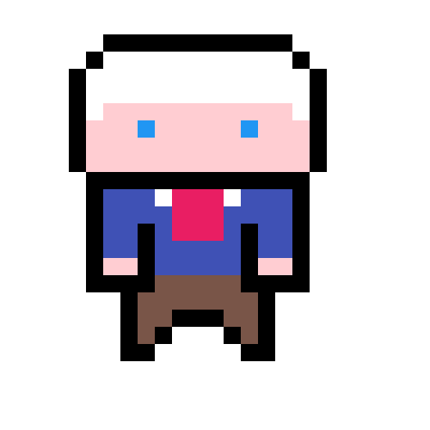
Game Introduction
You are a student at UCLA trying to save Gene Block from certain doom. He has been captured by students who have been driven to the point of rage from sleep and financial aid deprivation. Pulling all those all-nighters has turned them into zombies! You are equipped with Yerba Mates. Throw them at the quickly approaching zombie-students to wake them up.

Slide 3
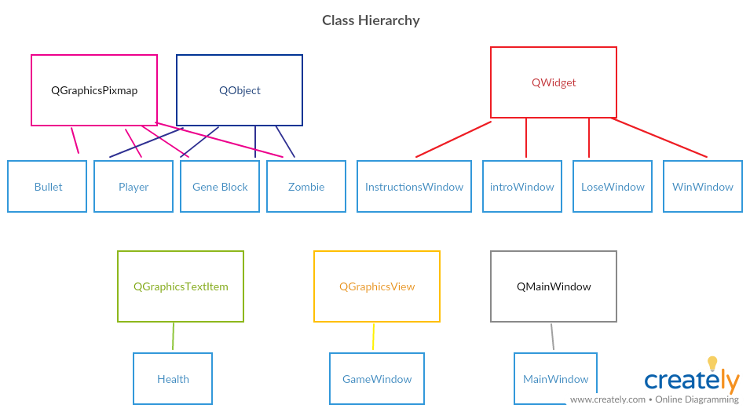

Slide 4
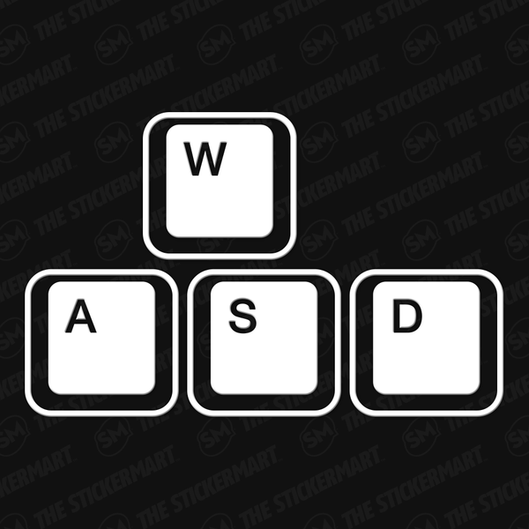
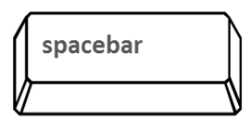
How To Play
Control the player using:
W for Up
A for Left
S for Down
D for Right
Use the mouse to aim and spacebar to shoot Yerbas!

Slide 5
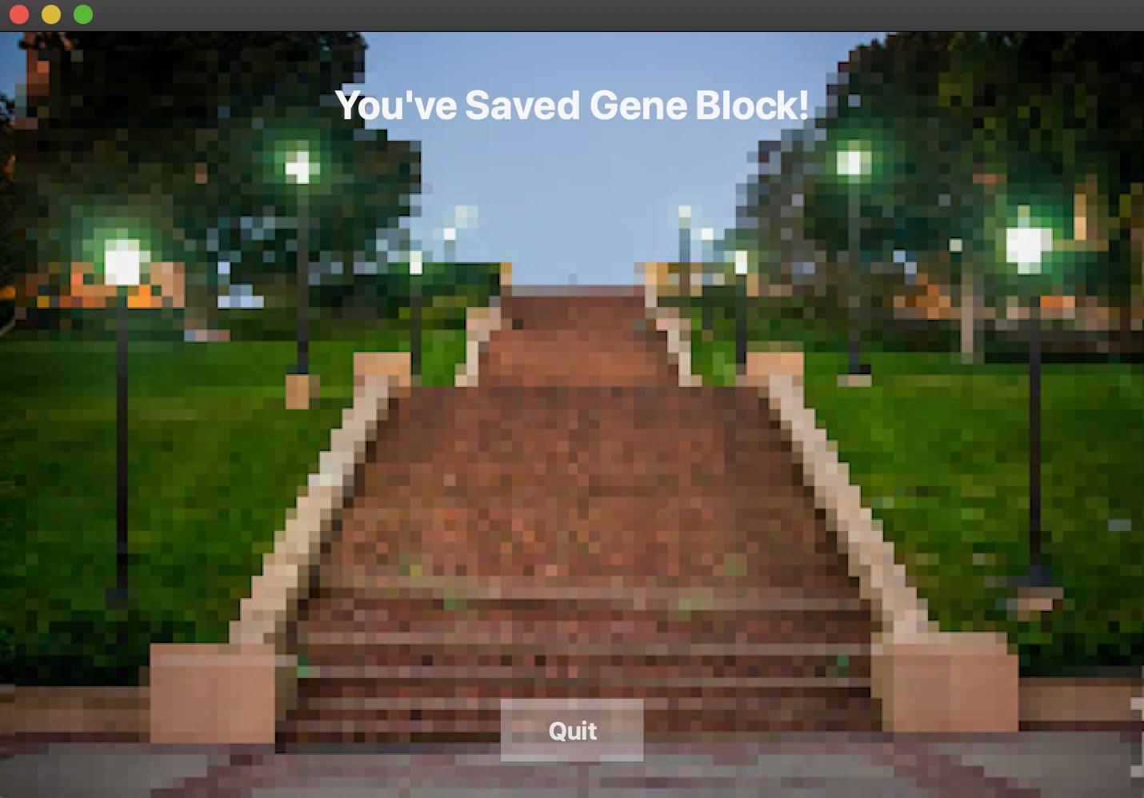
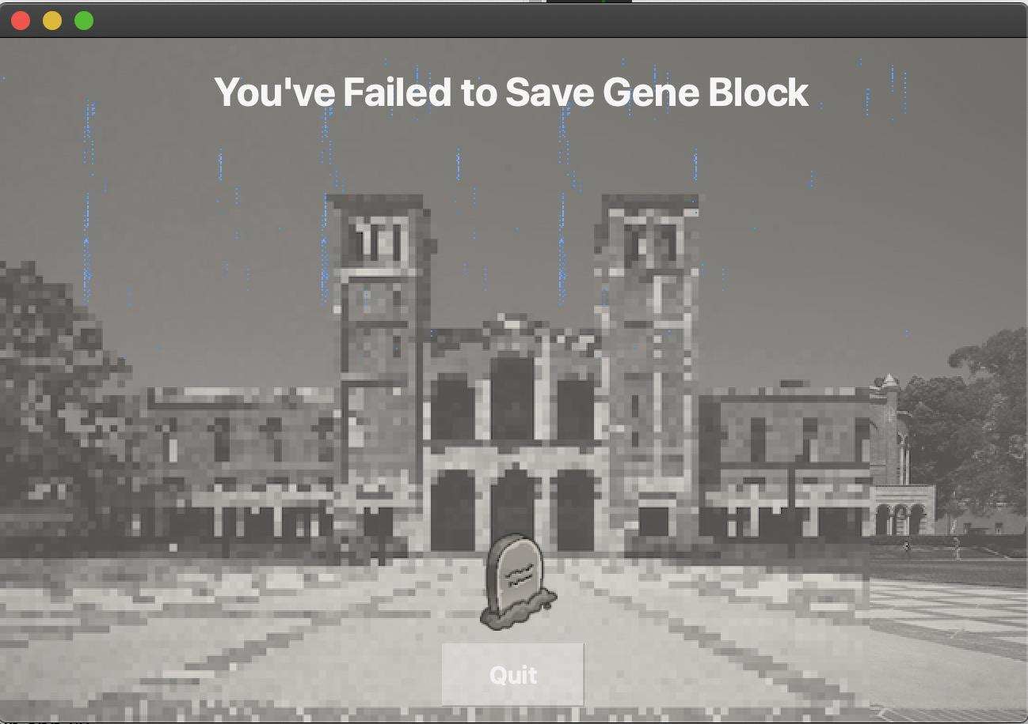
QWidgets
The following QWidgets make it so new windows appear, all for different purposes:
introWindow: opens when the program initially runs, allows the player to select difficulty level, and open the InstructionsWindow if pushButton to do so is pressed
InstructionsWindow: Lets the player know how to play the game
LoseWindow: appears if Gene Block QObject dies
WinWindow: appears if the player completes the game and Gene Block is alive

Slide 6
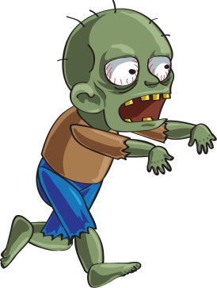
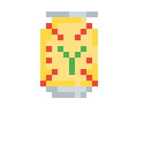

QObjects and QGraphicsPixmap
Bullet, GeneBlock, Zombie, and Player all inherit from QObject and QGraphicsPixmap. These objects exist in the game and their location is based on a coordinate system.

Slide 7
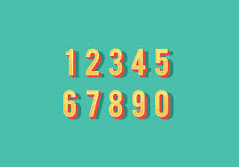
QGraphicsTextItem
Health inherits from QGraphicsTextItem. Gene Block’s health is represented by a number at the top left corner of the screen, and decreases once a zombie reaches him. Once it reaches zero, the game is over and the player loses.

Slide 8


